Slide 1
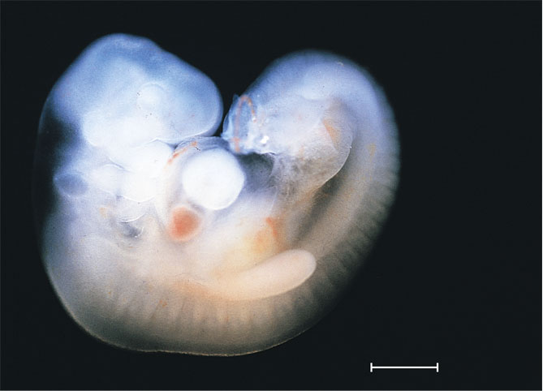
A human embryo about six to eight weeks after conception
1 mm

Slide 2
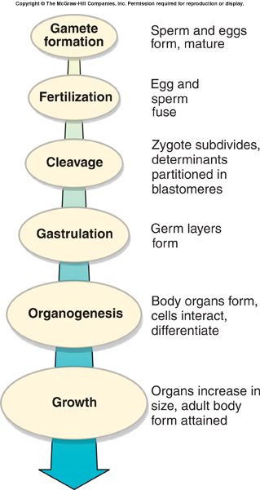
Key Events in Development
Development describes the changes in an organism from its earliest beginnings through maturity.

Slide 3
Fertilization
Fertilization is the initial event in development in sexual reproduction.
  Union of male and female gametes
  Provides for recombination of paternal and maternal genes.
    Restores the diploid number.
  Activates the egg to begin development.

Slide 4
Fertilization
Oocyte Maturation
  Egg grows in size by accumulating yolk.
    Contains much mRNA, ribosomes, tRNA and elements for protein synthesis.
  Morphogenetic determinants direct the activation and repression of specific genes later in post-fertilization development.
  Egg nucleus grows in size, bloated with RNA.
    Now called the germinal vesicle.

Slide 5
Fertilization
Most of these preparations in the egg occur during the prolonged prophase I.
  In mammals
Oocyte now has a highly structured system.
  After fertilization it will support nutritional requirements of the embryo and direct its development through cleavage.
After meiosis resumes, the egg is ready to fuse its nucleus with the sperm nucleus.

Slide 6
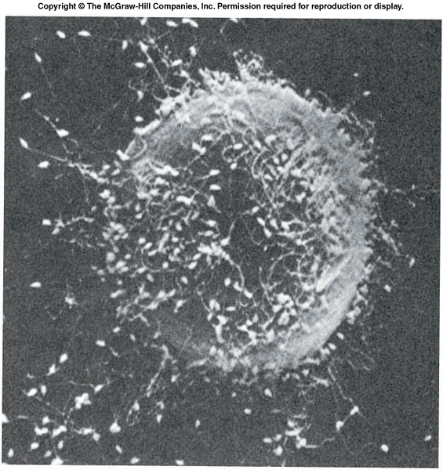
Fertilization in Sea Urchins
Prevention of polyspermy – only one sperm can enter.
  Fast block
    Depolarization of membrane
  Slow block
    Cortical reaction resulting in fertilization membrane

Slide 7
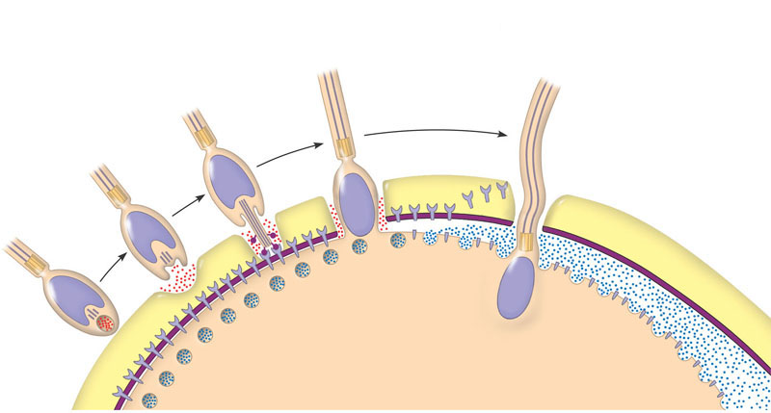
The acrosomal and cortical reactions during sea urchin fertilization
1
2
3
4
5
Contact. The
sperm cell
contacts the
egg’s jelly coat,
triggering
exocytosis from the
sperm’s acrosome.
Acrosomal reaction. Hydrolytic
enzymes released from the
acrosome make a hole in the
jelly coat, while growing actin
filaments form the acrosomal
process. This structure protrudes
from the sperm head and
penetrates the jelly coat, binding
to receptors in the egg cell
membrane that extend through
the vitelline layer.
Contact and fusion of sperm
and egg membranes. A hole
is made in the vitelline layer,
allowing contact and fusion of
the gamete plasma membranes.
The membrane becomes
depolarized, resulting in the
fast block to polyspermy.
Entry of
sperm nucleus.
Cortical reaction. Fusion of the
gamete membranes triggers an
increase of Ca²⁺ in the egg’s
cytosol, causing cortical granules
in the egg to fuse with the plasma
membrane and discharge their
contents. This leads to swelling of the
perivitelline space, hardening of the
vitelline layer, and clipping of
sperm-binding receptors. The resulting
fertilization envelope is the slow block
to polyspermy.
Sperm plasma
membrane
Sperm
nucleus
Acrosomal
process
Basal body
(centriole)
Sperm
head
Fertilization
envelope
Fused plasma
membranes
Cortical
granule
Actin
Perivitelline
space
Hydrolytic enzymes
Acrosome
Cortical granule
membrane
Jelly coat
Vitelline layer
Sperm-binding
receptors
Egg plasma
membrane
EGG CYTOPLASM

Slide 8
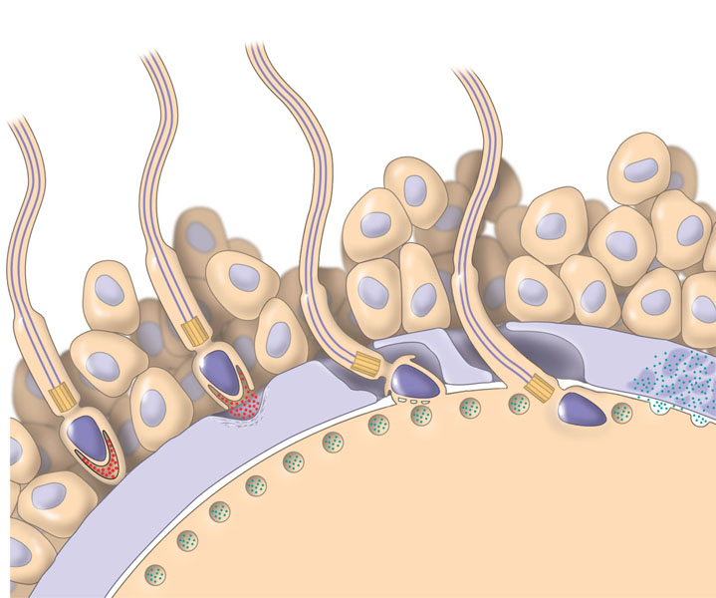
Early events of fertilization in mammals
1
Breakdown of the zona pellucida
by these enzymes allows the sperm
to reach the plasma membrane
of the egg. Membrane proteins of the
sperm bind to receptors on the egg
membrane, and the two membranes fuse.
This binding induces
the acrosomal reaction,
in which the sperm
releases hydrolytic
enzymes into the
zona pellucida.
3
2
The nucleus and other
components of the sperm
cell enter the egg.
The sperm migrates
through the coat of
follicle cells and
binds to receptor
molecules in the
zona pellucida of
the egg. (Receptor
molecules are not
shown here.)
4
Follicle
cell
Enzymes released during
the cortical reaction harden
the zona pellucida, which
now functions as a block to
polyspermy.
5
Zone
pellucida
Sperm
basal
body
Cortical
granules
Sperm
nucleus
Egg plasma
membrane
Acrosomal
vesicle
EGG CYTOPLASM

Slide 9
Fertilization in Sea Urchins
The cortical reaction follows the fusion of thousands of enzyme-rich cortical granules with the egg membrane.
  Cortical granules release contents between the membrane and vitelline envelope.
  Creates an osmotic gradient
    Water rushes into space
    Elevates the envelope
    Lifts away all bound sperm except the one sperm that has successfully fused with the egg plasma membrane.

Slide 10
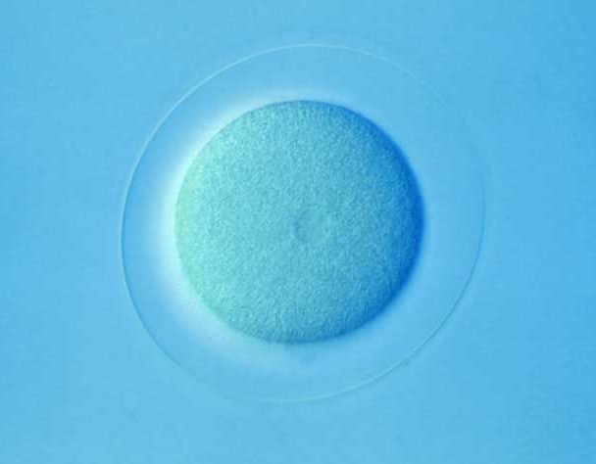
Fertilization in Sea Urchins
One cortical granule enzyme causes the vitelline envelope to harden.
  Now called the fertilization membrane.
  Block to polyspermy is now complete.
Similar process occurs in mammals.

Slide 11
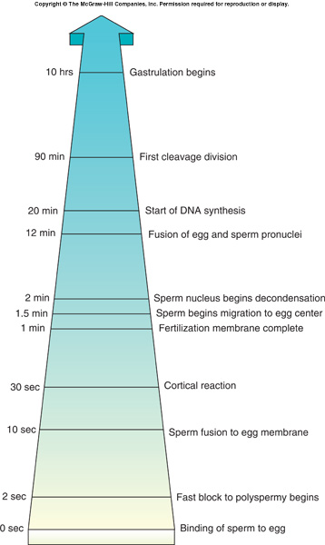
Fertilization in Sea Urchins
The increased Ca²⁺ concentration in the egg after the cortical reaction results in an increase in the rates of cellular respiration and protein synthesis.
  The egg is activated.

Slide 12
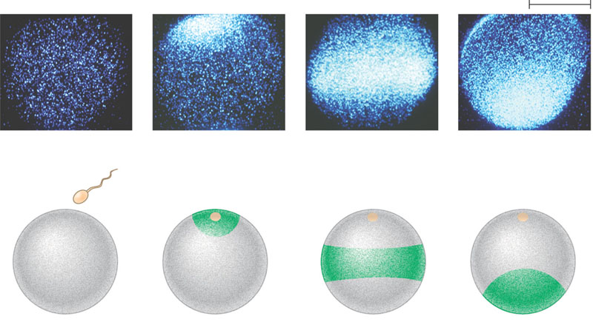
What is the effect of sperm binding on Ca²⁺ distribution in the egg?
EXPERIMENT
A fluorescent dye that glows when it binds free Ca²⁺ was injected into unfertilized sea urchin eggs. After sea urchin
sperm were added, researchers observed the eggs in a fluorescence microscope.
RESULTS
500 μm
1 sec before
fertilization
10 sec after
fertilization
20 sec
30 sec
Point of
Sperm
entry
Spreading wave
of calcium ions
The release of Ca²⁺ from the endoplasmic reticulum into the cytosol at the site of sperm entry triggers the release
of more and more Ca²⁺ in a wave that spreads to the other side of the cell. The entire process takes about 30 seconds.
CONCLUSION

Slide 13
Key Events in Development
Specialization of cell types occurs as a hierarchy of developmental decisions.
  Cell types arise from conditions created in preceding stages.
  Interactions become increasingly restrictive.
With each new stage:
  Each stage limits developmental fate.
  Cells lose option to become something different
    Said to be determined.

Slide 14
Key Events in Development
The two basic processes responsible for this progressive subdivision:
  Cytoplasmic localization
  Induction

Slide 15
Fusion of Pronuclei
After sperm and egg membranes fuse, the sperm loses its flagellum.
Fusion of male and female pronuclei forms a diploid zygote nucleus.

Slide 16
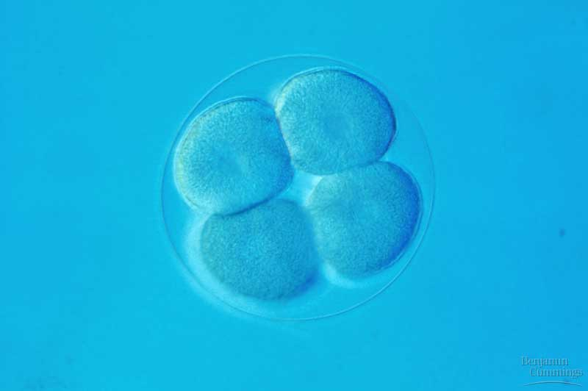
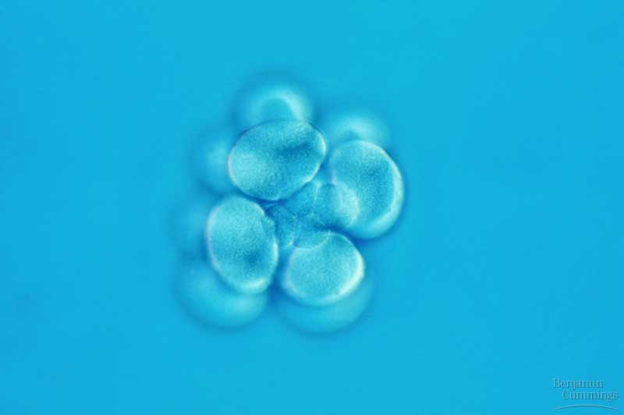
Cleavage
Cleavage – rapid cell divisions following fertilization.
  Very little growth occurs.
  Each cell called a blastomere.
  Morula – solid ball of cells. First 5-7 divisions.

Slide 17
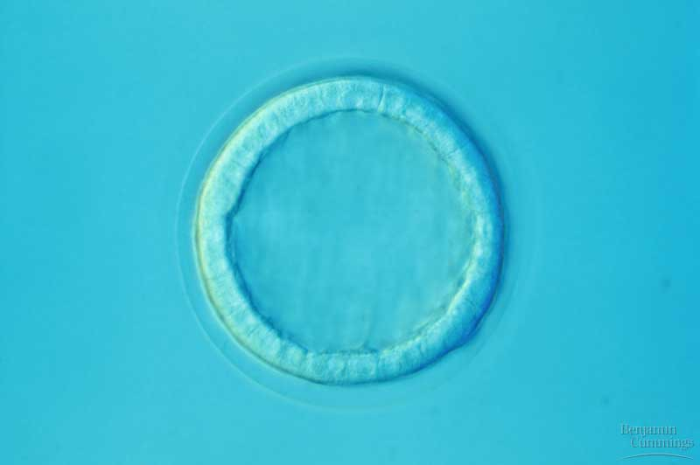
Blastula
A fluid filled cavity, the blastocoel, forms within the embryo – a hollow ball of cells now called a blastula.

Slide 18
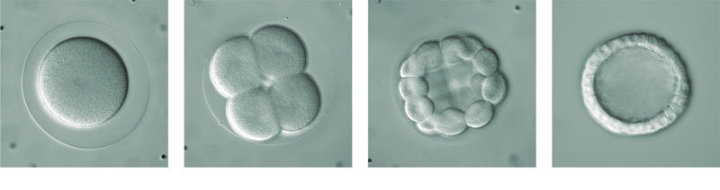
Cleavage in an echinoderm embryo
(a)
Fertilized egg. Shown here is the
zygote shortly before the first
cleavage division, surrounded
by the fertilization envelope.
The nucleus is visible in the
center.
(b)
Four-cell stage. Remnants of the
mitotic spindle can be seen
between the two cells that have
just completed the second
cleavage division.
(c)
Morula. After further cleavage
divisions, the embryo is a
multicellular ball that is still
surrounded by the fertilization
envelope. The blastocoel cavity
has begun to form.
(d)
Blastula. A single layer of cells
surrounds a large blastocoel
cavity. Although not visible here,
the fertilization envelope is still
present; the embryo will soon
hatch from it and begin swimming.

Slide 19
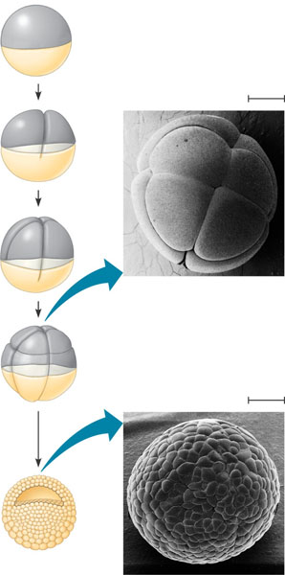
Cleavage in a frog embryo
Zygote
0.25 mm
2-cell
stage
forming
Eight-cell stage (viewed from the animal pole). The large amount of yolk displaces the third cleavage toward the animal pole, forming two tiers of cells. The four cells near the animal pole
(closer, in this view) are smaller than the other four cells (SEM).
4-cell
stage
forming
8-cell
stage
0.25 mm
Blastula (at least 128 cells). As cleavage continues, a fluid-filled cavity, the blastocoel, forms within the embryo. Because of unequal cell division due to the large amount of yolk in the vegetal hemisphere, the blastocoel is located in the animal hemisphere, as
shown in the cross section. The SEM shows the outside of a blastula with about 4,000 cells, looking at the animal pole.
Animal pole
Blasto-
coel
Blastula
(cross
section)
Vegetal pole

Slide 20
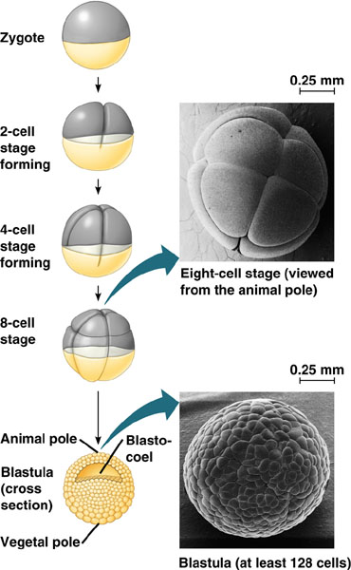
Cleavage in Frogs
Cleavage planes usually follow a specific pattern that is relative to the animal and vegetal poles of the zygote.
  Animal pole blastomeres are smaller.
  Blastocoel in animal hemisphere.
  Little yolk, cleavage furrows complete.
  Holoblastic cleavage

Slide 21
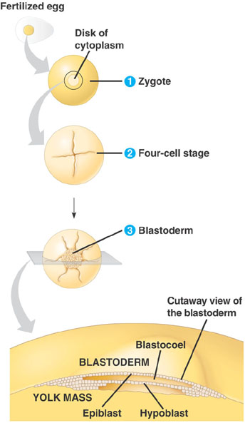
Cleavage in Birds
Meroblastic cleavage, incomplete division of the egg.
  Occurs in species with yolk-rich eggs, such as reptiles and birds.
  Blastoderm – cap of cells on top of yolk.

Slide 22
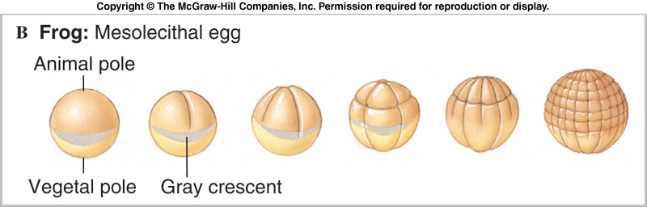
Polarity
The eggs and zygotes of many animals (not mammals) have a definite polarity.
The polarity is defined by the distribution of yolk.
  The vegetal pole has the most yolk and the animal pole has the least.

Slide 23
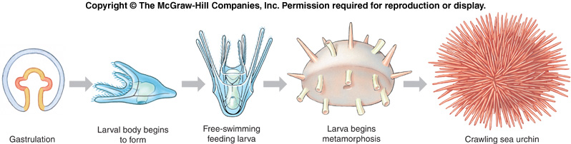
Direct vs. Indirect Development
When lots of nourishing yolk is present, embryos develop into a miniature adult.
  Direct development
When little yolk is present, young develop into larval stages that can feed.
  Indirect development
Mammals have little yolk, but nourish the embryo via the placenta.

Slide 24
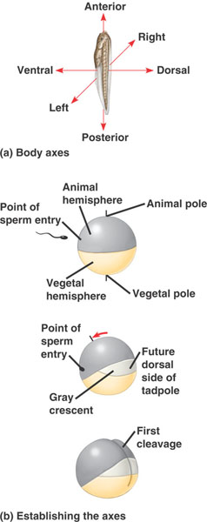
Body Axes
The development of body axes in frogs is influenced by the polarity of the egg.
The polarity of the egg determines the anterior-posterior axis before fertilization.
At fertilization, the pigmented cortex slides over the underlying cytoplasm toward the point of sperm entry. This rotation (red arrow) exposes a region of lighter-colored cytoplasm, the gray crescent, which is a marker of the dorsal side.
The first cleavage division bisects the gray crescent. Once the anterior-posterior and dorsal-ventral axes are defined, so is the left-right axis.

Slide 25
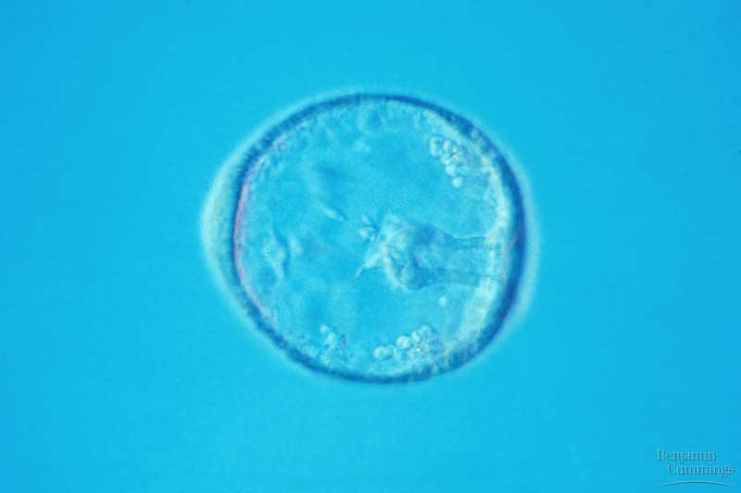
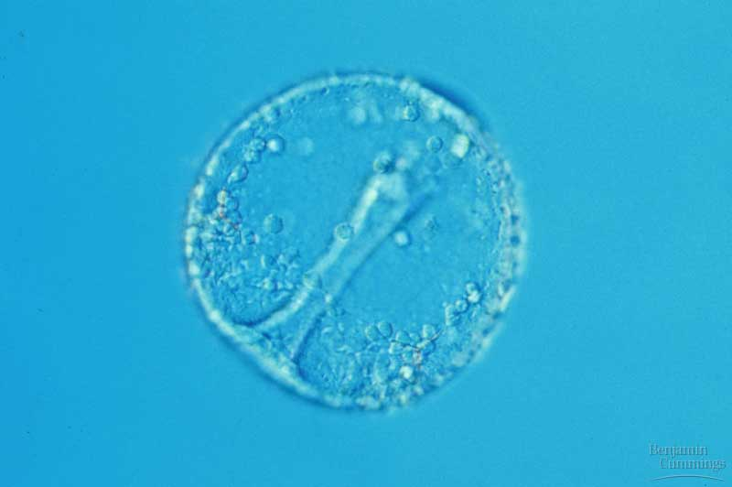
Gastrulation
The morphogenetic process called gastrulation rearranges the cells of a blastula into a three-layered (triploblastic) embryo, called a gastrula, that has a primitive gut.
  Diploblastic organisms have two germ layers.

Slide 26
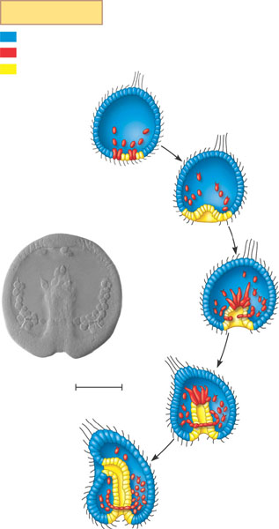
Gastrulation in a sea urchin embryo (layer 1)
Key
Future ectoderm
Future mesoderm
Future endoderm
Animal
pole
Blastocoel
Mesenchyme
cells
Vegetal
plate
Vegetal
pole

Slide 27
Gastrulation in a sea urchin embryo (layer 2)
Key
Future ectoderm
Future mesoderm
Future endoderm
Animal
pole
Blastocoel
Mesenchyme
cells
Vegetal
plate
Vegetal
pole
Blastocoel
Filopodia
pulling
archenteron
tip
Archenteron
Mesenchyme
cells
Blastopore
50 µm

Slide 28
Gastrulation in a sea urchin embryo (layer 3)
Key
Future ectoderm
Future mesoderm
Future endoderm
Animal
pole
Blastocoel
Mesenchyme
cells
Vegetal
plate
Vegetal
pole
Blastocoel
Filopodia
pulling
archenteron
tip
Archenteron
Mesenchyme
cells
Blastopore
50 µm
Blastocoel
Ectoderm
Archenteron
Mesenchyme:
(mesoderm
forms future
skeleton)
Mouth
Blastopore
Digestive tube (endoderm)
Anus (from blastopore)

Slide 29
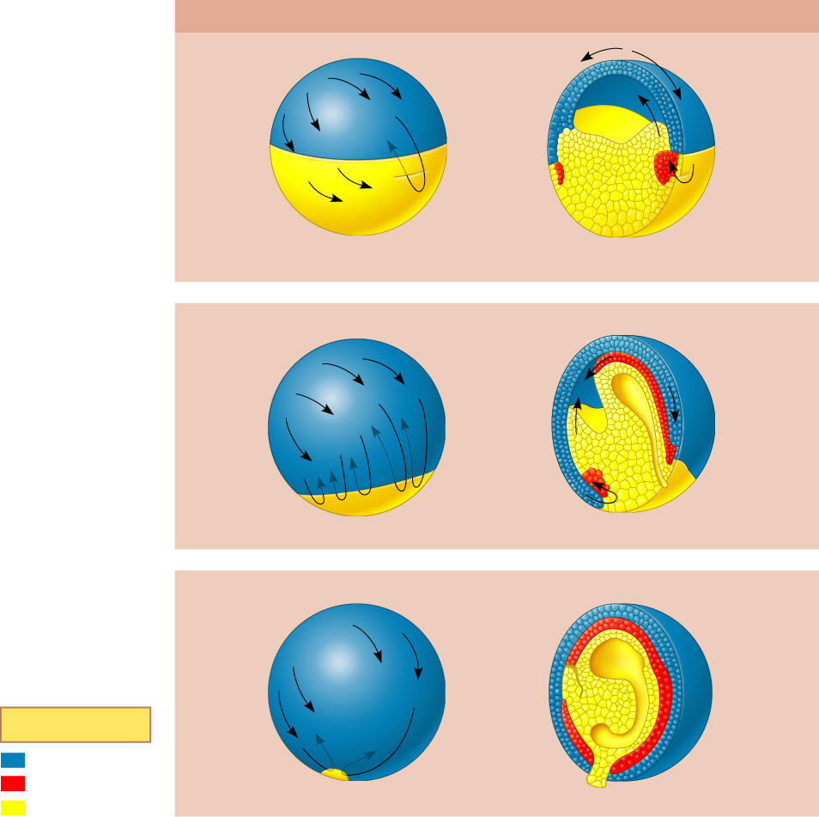
Gastrulation in a frog embryo
SURFACE VIEW
CROSS SECTION
1
Gastrulation begins when a small indented crease,
the dorsal lip of the blastopore, appears on one
side of the blastula. The crease is formed by cells
changing shape and pushing inward from the
surface (invagination). Additional cells then roll
inward over the dorsal lip (involution) and move into
the interior, where they will form endoderm and
mesoderm. Meanwhile, cells of the animal pole, the
future ectoderm, change shape and begin spreading
over the outer surface.
Animal pole
Blastocoel
Dorsal lip
of blastopore
Dorsal lip
of blastopore
Vegetal pole
Blastula
Blastocoel
shrinking
Archenteron
2
The blastopore lip grows on both sides of the
embryo, as more cells invaginate. When the sides
of the lip meet, the blastopore forms a circle that
becomes smaller as ectoderm spreads downward
over the surface. Internally, continued involution
expands the endoderm and mesoderm, and the
archenteron begins to form; as a result, the
blastocoel becomes smaller.
3
Ectoderm
Late in gastrulation, the endoderm-lined archenteron
has completely replaced the blastocoel and the
three germ layers are in place. The circular blastopore
surrounds a plug of yolk-filled cells.
Blastocoel
remnant
Mesoderm
Endoderm
Key
Future ectoderm
Future mesoderm
Yolk plug
Yolk plug
Gastrula
Future endoderm

Slide 30
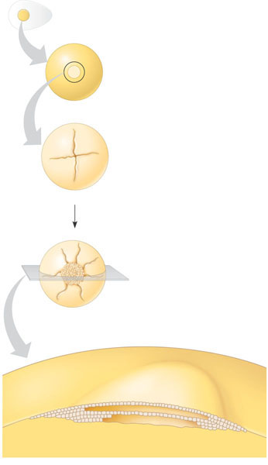
Cleavage in a chick embryo
Fertilized egg
Disk of
cytoplasm
Zygote. Most of the cell’s volume is yolk, with a small disk
of cytoplasm located at the animal pole.
1
2
Four-cell stage. Early cell divisions are meroblastic
(incomplete). The cleavage furrow extends through the
cytoplasm but not through the yolk.
Blastoderm. The many cleavage divisions produce the
blastoderm, a mass of cells that rests on top of the yolk mass.
3
Cutaway view of the blastoderm. The cells of the
blastoderm are arranged in two layers, the epiblast
and hypoblast, that enclose a fluid-filled cavity, the
blastocoel.
Blastocoel
BLASTODERM
YOLK MASS
Epiblast
Hypoblast

Slide 31
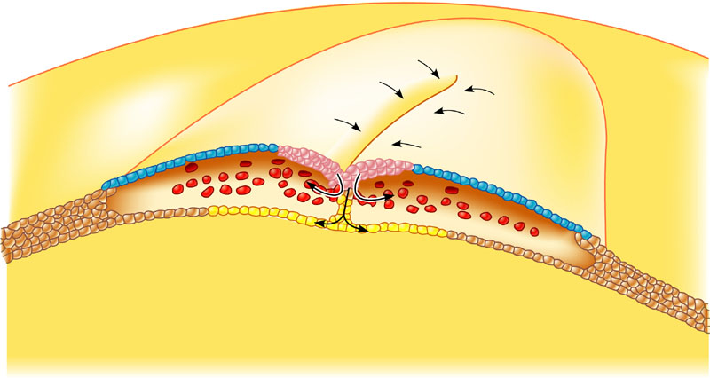
Gastrulation in a chick embryo
Epiblast
Future
ectoderm
Primitive
streak
Migrating
cells
(mesoderm)
Endoderm
Hypoblast
YOLK

Slide 32
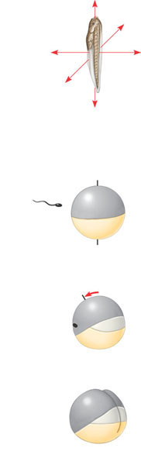
The body axes and their establishment in an amphibian
(a)
Body axes. The three axes of the fully developed embryo, the
tadpole, are shown above.
Anterior
Right
Ventral
Dorsal
Left
Posterior
Animal
hemisphere
Point of
sperm entry
Animal pole
1
The polarity of the egg determines the anterior-posterior axis
before fertilization.
Vegetal
hemisphere
Vegetal pole
Point of
sperm
entry
2
At fertilization, the pigmented cortex slides over the underlying
cytoplasm toward the point of sperm entry. This rotation (red arrow)
exposes a region of lighter-colored cytoplasm, the gray crescent,
which is a marker of the dorsal side.
Future
dorsal
side of
tadpole
Gray
crescent
First
cleavage
3
The first cleavage division bisects the gray crescent. Once the anterior-
posterior and dorsal-ventral axes are defined, so is the left-right axis.
(b)
Establishing the axes. The polarity of the egg and cortical rotation are critical in setting up the body axes.

Slide 33
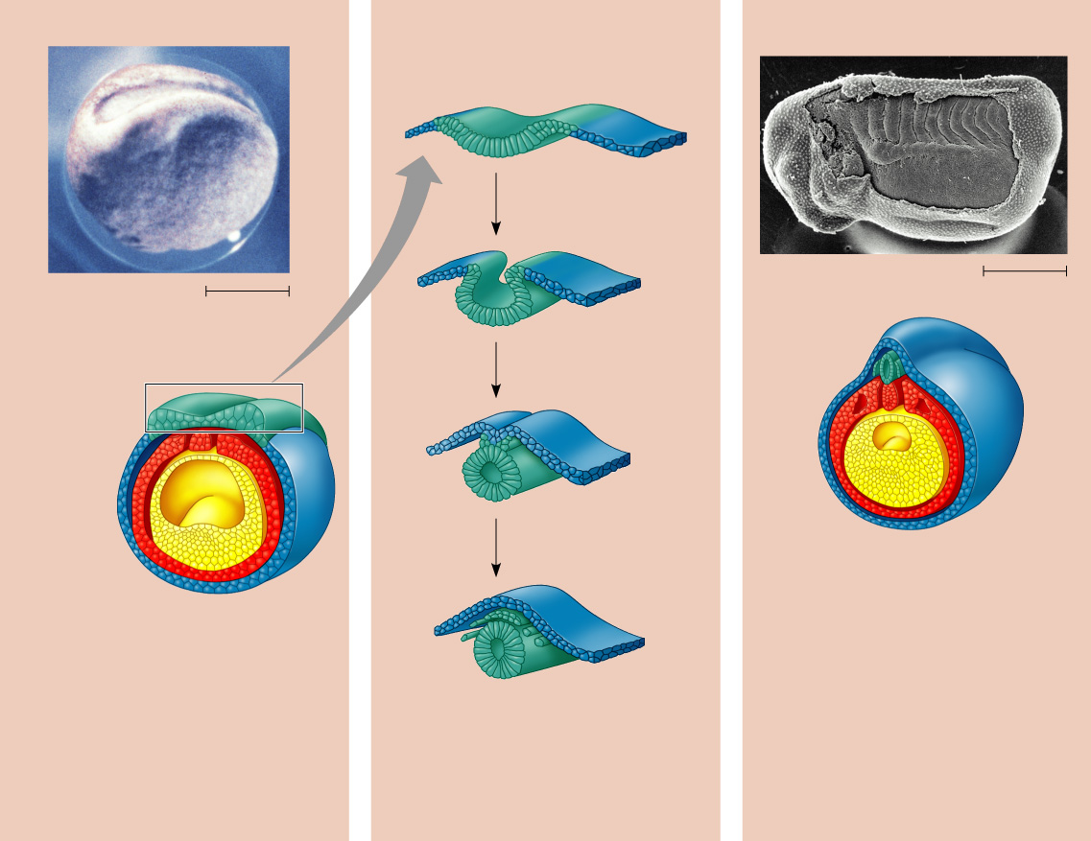
Early organogenesis in a frog embryo
Neural folds
Eye
Somites
Tail bud
Neural
fold
Neural plate
SEM
Neural tube
1 mm
LM
1 mm
Neural
fold
Neural
plate
Notochord
Neural
crest
Neural crest
Coelom
Somite
Notochord
Ectoderm
Mesoderm
Outer layer
of ectoderm
Archenteron
(digestive cavity)
Endoderm
Archenteron
Neural crest
(c)
Somites. The drawing shows an embryo
after completion of the neural tube. By
this time, the lateral mesoderm has
begun to separate into the two tissue
layers that line the coelom; the somites,
formed from mesoderm, flank the
notochord. In the scanning electron
micrograph, a side view of a whole
embryo at the tail-bud stage, part of the
ectoderm has been removed, revealing
the somites, which will give rise to
segmental structures such as vertebrae
and skeletal muscle.
(a)
Neural plate formation. By the time
shown here, the notochord has
developed from dorsal mesoderm,
and the dorsal ectoderm has
thickened, forming the neural plate,
in response to signals from the
notochord. The neural folds are
the two ridges that form the lateral
edges of the neural plate. These
are visible in the light micrograph
of a whole embryo.
Neural tube
(b)
Formation of the neural tube.
Infolding and pinching off of the
neural plate generates the neural tube.
Note the neural crest cells, which will
migrate and give rise to numerous
structures.

Slide 34
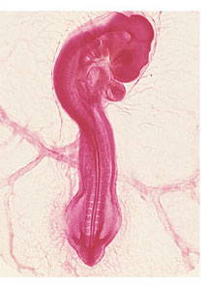
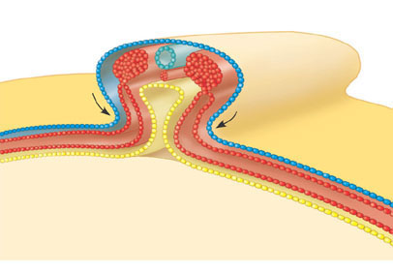
Organogenesis in a chick embryo
Eye
Neural tube
Forebrain
Notochord
Somite
Heart
Coelom
Archenteron
Lateral fold
Endoderm
Blood
vessels
Mesoderm
Ectoderm
YOLK
Yolk stalk
Somites
Yolk sac
Form extraembryonic
membranes
Neural tube
(a)
Early organogenesis. The archenteron forms when lateral folds
pinch the embryo away from the yolk. The embryo remains open
to the yolk, attached by the yolk stalk, about midway along its length,
as shown in this cross section. The notochord, neural tube, and
somites subsequently form much as they do in the frog.
(b)
Late organogenesis. Rudiments of most
major organs have already formed in this
chick embryo, which is about 56 hours old
and about 2–3 mm long (LM).

Slide 35
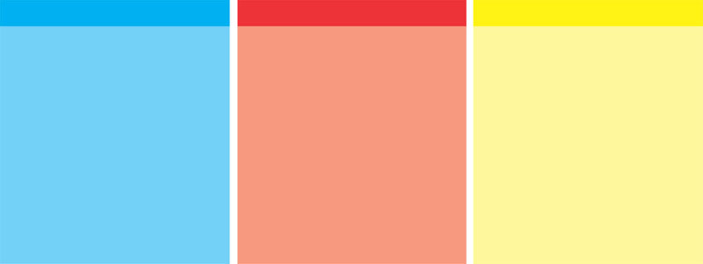
Adult derivatives of the three embryonic germ layers in vertebrates
ECTODERM
MESODERM
ENDODERM
• Epidermis of skin and its
derivatives (including sweat
glands, hair follicles)
• Epithelial lining of mouth
and rectum
• Sense receptors in
epidermis
• Cornea and lens of eye
• Nervous system
• Adrenal medulla
• Tooth enamel
• Epithelium or pineal and
pituitary glands
• Notochord
• Skeletal system
• Muscular system
• Muscular layer of
stomach, intestine, etc.
• Excretory system
• Circulatory and lymphatic
systems
• Reproductive system
(except germ cells)
• Dermis of skin
• Lining of body cavity
• Adrenal cortex
• Epithelial lining of
digestive tract
• Epithelial lining of
respiratory system
• Lining of urethra, urinary
bladder, and reproductive
system
• Liver
• Pancreas
• Thymus
• Thyroid and parathyroid
glands

Slide 36
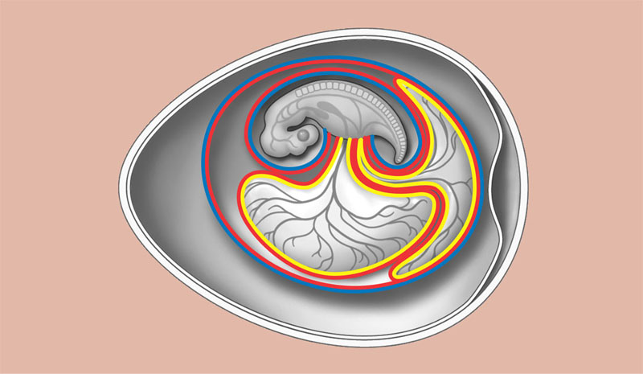
Extraembryonic membranes in birds and other reptiles
Allantois. The allantois
functions as a disposal sac for
certain metabolic wastes
produced by the embryo. The
membrane of the allantois
also functions with the
chorion as a respiratory organ.
Amnion. The amnion protects
the embryo in a fluid-filled
cavity that prevents
dehydration and cushions
mechanical shock.
Embryo
Amniotic
cavity
with
amniotic
fluid
Albumen
Shell
Yolk
(nutrients)
Chorion. The chorion and the
membrane of the allantois
exchange gases between the
embryo and the surrounding
air. Oxygen and carbon dioxide
diffuse freely across the egg’s
shell.
Yolk sac. The yolk sac expands
over the yolk, a stockpile of
nutrients stored in the egg.
Blood vessels in the yolk sac
membrane transport nutrients
from the yolk into the embryo.
Other nutrients are stored in
the albumen (the ”egg white”).

Slide 37
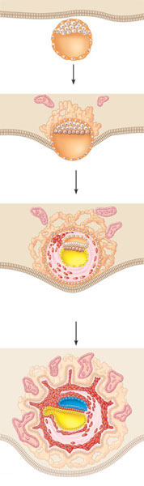
Four stages in early embryonic development of a human
Endometrium
(uterine lining)
Inner cell mass
Trophoblast
1
Blastocyst
reaches uterus.
Blastocoel
Expanding
region of
trophoblast
Maternal
blood
vessel
Epiblast
Hypoblast
Trophoblast
2
Blastocyst
implants.
Expanding
region of
trophoblast
Amnion
Amniotic
cavity
Epiblast
Hypoblast
3
Extraembryonic
membranes
start to form and
gastrulation begins.
Chorion (from
trophoblast)
Extraembryonic mesoderm cells
(from epiblast)
Yolk sac (from
hypoblast)
Allantois
Amnion
Chorion
Ectoderm
Mesoderm
Endoderm
4
Gastrulation has produced a three-
layered embryo with four
extraembryonic membranes.
Yolk sac
Extraembryonic
mesoderm

Slide 38
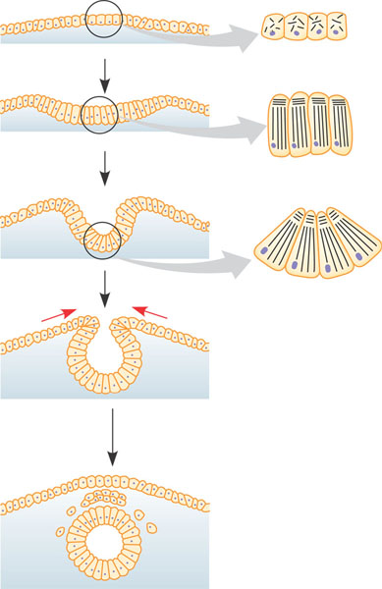
Change in cellular shape during morphogenesis
Ectoderm
Neural
plate
1
Microtubules help elongate
the cells of the neural plate.
2
Microfilaments at the dorsal
end of the cells may then contract,
deforming the cells into wedge shapes.
3
Cell wedging in the opposite
direction causes the ectoderm to
form a “hinge.”
4
Pinching off of the neural plate
forms the neural tube.

Slide 39
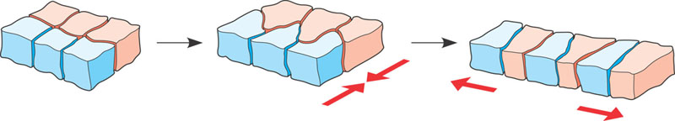
Convergent extension of a sheet of cells
Convergence
Extension

Slide 40
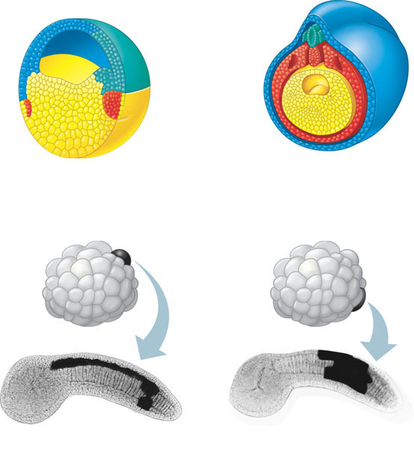
Fate mapping for two chordates
Epidermis
Central
nervous
system
Epidermis
Notochord
Mesoderm
Endoderm
Neural tube stage
(transverse section)
Blastula
(a)
Fate map of a frog embryo. The fates of groups of cells in a frog blastula (left) were
determined in part by marking different regions of the blastula surface with nontoxic dyes
of various colors. The embryos were sectioned at later stages of development, such as
the neural tube stage shown on the right, and the locations of the dyed cells determined.
(b)
Cell lineage analysis in a tunicate. In lineage analysis, an individual cell is injected with a
dye during cleavage, as indicated in the drawings of 64-cell embryos of a tunicate, an
invertebrate chordate. The dark regions in the light micrographs of larvae correspond to
the cells that developed from the two different blastomeres indicated in the drawings.

Slide 41
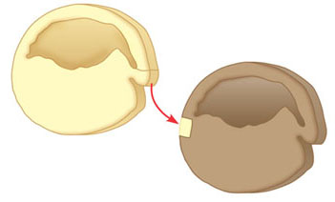
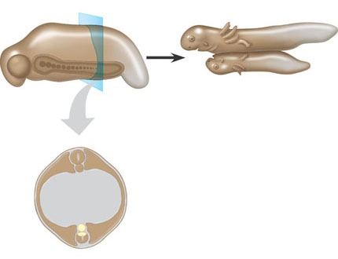
Can the dorsal lip of the blastopore induce cells in another part of the amphibian embryo to change their developmental fate?
EXPERIMENT
Spemann and Mangold transplanted a piece of the dorsal lip of a pigmented newt gastrula to the
ventral side of the early gastrula of a nonpigmented newt.
Pigmented gastrula
(donor embryo)
Dorsal lip of
blastopore
Nonpigmented gastrula
(recipient embryo)
RESULTS
During subsequent development, the recipient embryo formed a second notochord and neural tube in
the region of the transplant, and eventually most of a second embryo. Examination of the interior of the double embryo
revealed that the secondary structures were formed in part from host tissue.
Primary embryo
Primary
structures:
Secondary (induced) embryo
Secondary
structures:
Neural tube
Notochord (pigmented cells)
Notochord
Neural tube (mostly nonpigmented cells)
CONCLUSION
The transplanted dorsal lip was able to induce cells in a different region of the recipient to form
structures different from their normal fate. In effect, the dorsal lip “organized” the later development of an entire embryo.

Slide 42
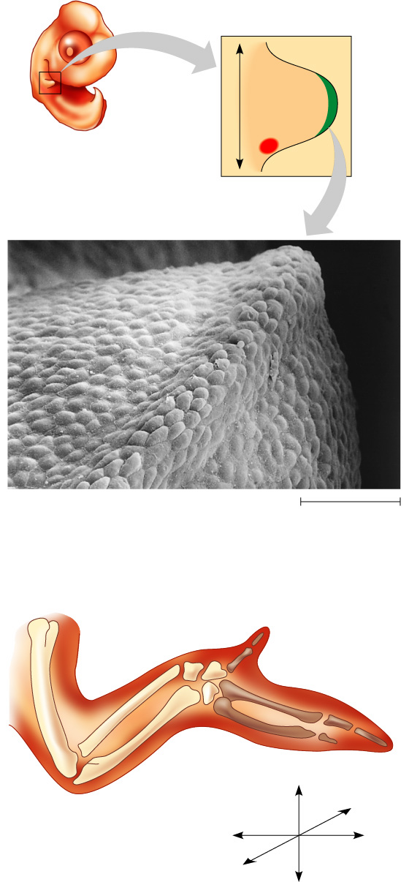
Vertebrate limb development
(a)
Organizer regions. Vertebrate limbs develop from
protrusions called limb buds, each consisting of
mesoderm cells covered by a layer of ectoderm.
Two regions, termed the apical ectodermal ridge
(AER, shown in this SEM) and the zone of polarizing
activity (ZPA), play key organizer roles in limb
pattern formation.
Anterior
AER
Limb bud
ZPA
Posterior
Apical
ectodermal
ridge
50 µm
(b)
Wing of chick embryo. As the bud develops into a
limb, a specific pattern of tissues emerges. In the
chick wing, for example, the three digits are always
present in the arrangement shown here. Pattern
formation requires each embryonic cell to receive
some kind of positional information indicating
location along the three axes of the limb. The AER
and ZPA secrete molecules that help provide this
information.
Digits
Anterior
Ventral
Proximal
Distal
Dorsal
Posterior

Slide 43
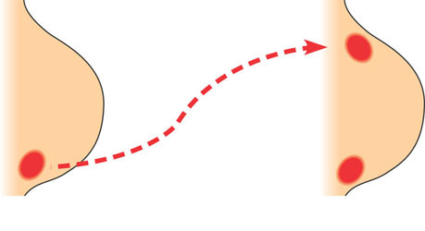
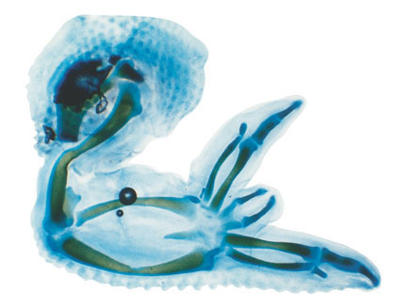
What role does the zone of polarizing activity (ZPA) play in limb pattern formation in vertebrates?
EXPERIMENT
ZPA tissue from a donor chick embryo was transplanted under the ectoderm in the
anterior margin of a recipient chick limb bud.
Anterior
New ZPA
Donor
limb
bud
Host
limb
bud
ZPA
Posterior
RESULTS
In the grafted host limb bud, extra digits developed from host tissue in a mirror-image
arrangement to the normal digits, which also formed (see Figure 47.26b for a diagram of a normal
chick wing).
CONCLUSION
The mirror-image duplication observed in this experiment suggests that ZPA cells secrete
a signal that diffuses from its source and conveys positional information indicating “posterior.” As the
distance from the ZPA increases, the signal concentration decreases and hence more anterior digits develop.

Slide 44
Overview of Development
Development is the successive process of systematic gene-directed changes throughout an organism’s life cycle
-Can be divided into four sub-processes:
-Growth (cell division)
-Differentiation
-Pattern formation
-Morphogenesis

Slide 45
Cell Division
After fertilization, the diploid zygote undergoes a period of rapid mitotic divisions
-In animals, this period is called cleavage
-Controlled by cyclins and cyclin- dependent kinases (Cdks)
During cleavage, the zygote is divided into smaller & smaller cells called blastomeres
-Moreover, the G1 and G2 phases are shortened or eliminated

Slide 46
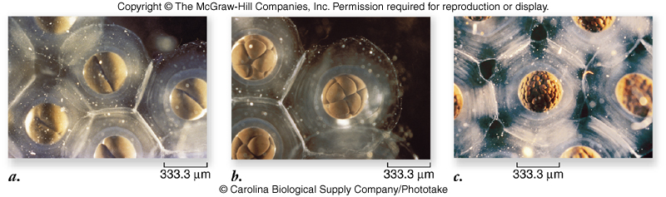
Cell Division

Slide 47
Stem cells
Blastomeres are nondifferentiated and can give rise to any tissue
Stem cells are set aside and will continue to divide while remaining undifferentiated
-Tissue-specific: can give rise to only one tissue
-Pluripotent: can give rise to multiple different cell types
-Totipotent: can give rise to any cell type, and whole organism

Slide 48
Stem cells
Cleave in mammals continues for 5-6 days
producing a ball of cells, the blastocyst
-Consists of:
-Outer layer = Forms the placenta
-Inner cell mass = Forms the embryo
-Source of embryonic stem cells (ES cells)

Slide 49
Cell Differentiation
A human body contains more than 210 major types of differentiated cells
Cell determination commits a cell to a particular developmental pathway
-Can only be “seen” by experiment
-Cells are moved to a different location in the embryo
-If they develop according to their new position, they are not determined

Slide 50
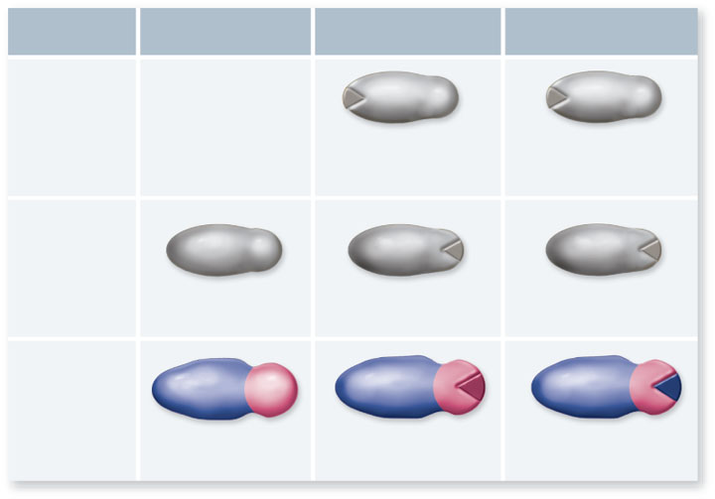
Normal
Not Determined
(early development)
Determined
(later development)
Donor
No donor
Tail cells are
transplanted
to head
Tail cells are
transplanted
to head
Recipient
Before Overt
Differentiation
Tail
Head
Recipient
After Overt
Differentiation
Tail cells develop
into head cells in head
Tail cells develop
into tail cells in head

Slide 51
Cell Differentiation
Cells initiate developmental changes by using transcriptional factors to change patterns of gene expression
Cells become committed to follow a particular developmental pathway in one of two ways:
1) via differential inheritance of cytoplasmic determinants
2) via cell-cell interactions

Slide 52
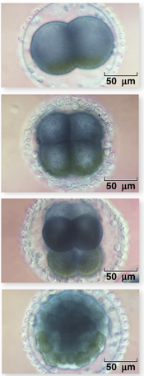
Cell Differentiation
Cytoplasmic determinants
-Female parent provides egg with macho-1 mRNA
-Encodes a transcription factor that can activate expression of muscle- specific genes

Slide 53
Cell Differentiation
Induction is the change in the fate of a cell due to interaction with an adjacent cell
If cells of a frog embryo are separated:
-One pole (“animal pole”) forms ectoderm
-Other pole (“vegetal pole”) forms endoderm
-No mesoderm is formed
If the two pole cells are placed side-by-side, some animal-pole cells form the mesoderm

Slide 54
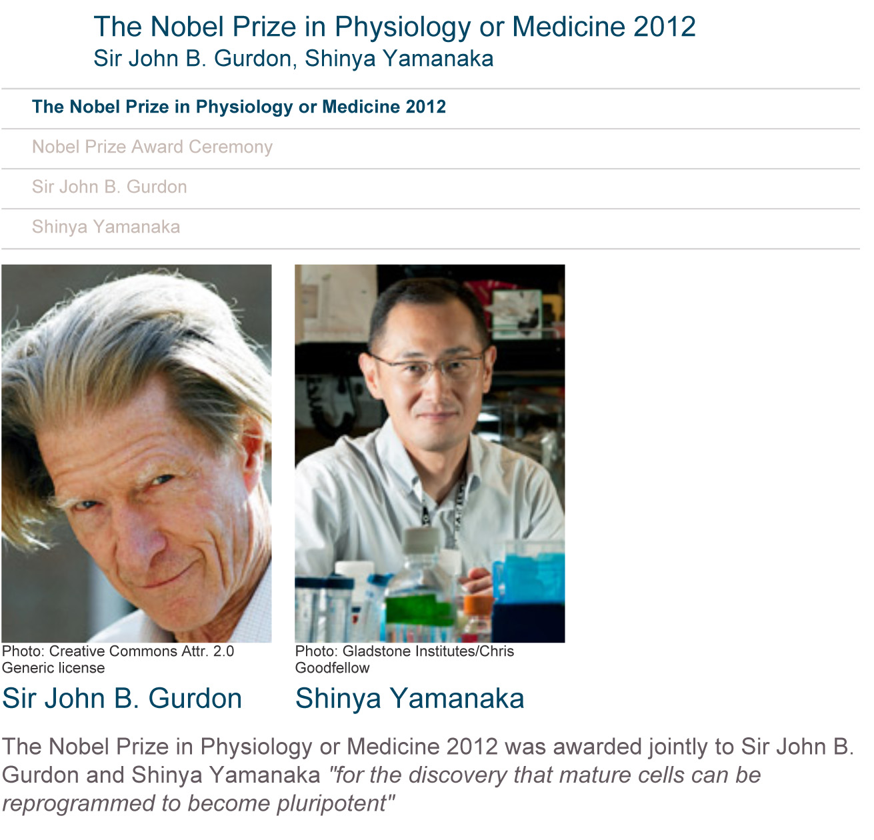

Slide 55
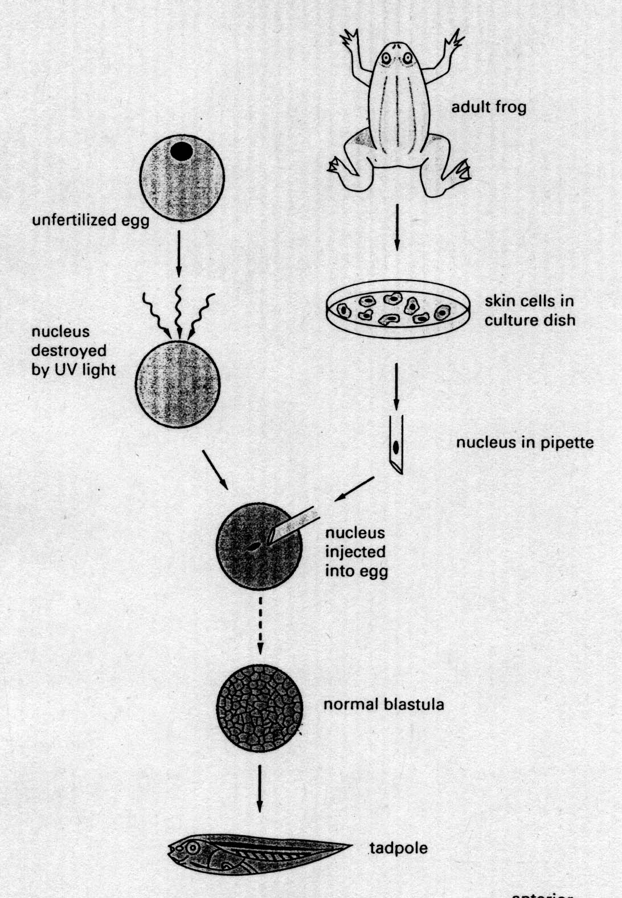
Transplantation experiment
John Gurdon

Slide 56
What does this transplantation experiment tell you?
Localized cytoplasm determinants are important
The genome stays the same during cell differentiation
Skin cells have the potential to generate all cell types
You don’t really need nuclei for cell differentiation
The oocyte without a nucleus did just fine

Slide 57
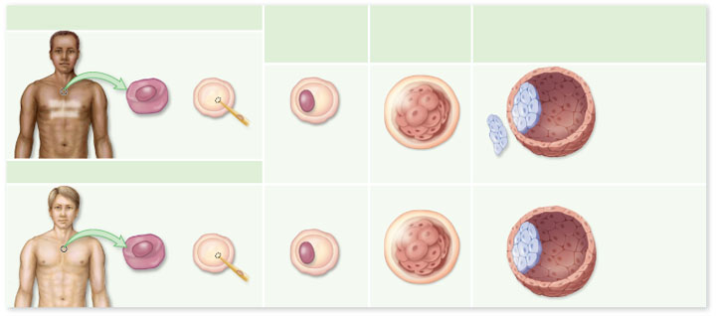
Cloning
The nucleus from a skin cell of a diabetic
patient is removed.
The skin cell
nucleus is inserted
into the enucleated
human egg cell.
Cell cleavage
occurs as the
embryo begins to
develop in vitro.
The embryo
reaches the
blastocyst stage
Inner cell
mass
Diabetic
patient
The nucleus from a skin cell of a healthy
patient is removed.
ES
cells
Early embryo
Blastocyst
Healthy
patient

Slide 58
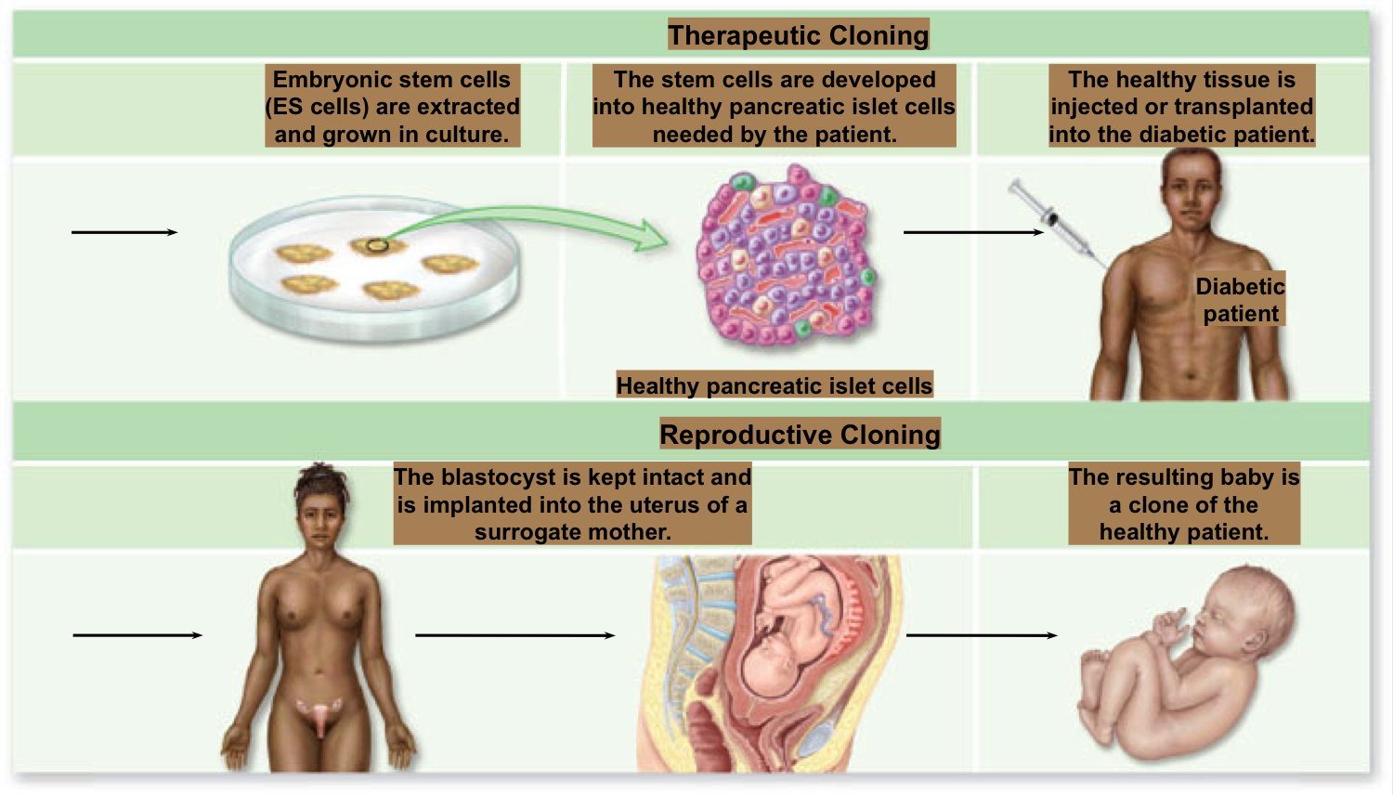
Cloning

Slide 59
Cloning
Human embryonic stem cells have enormous promise for treating a wide range of diseases
-However, stem cell research has raised profound ethical issues
Very few countries have permissive policy towards human reproductive cloning
-However, many permit embryonic stem cell research

Slide 60
Pattern Formation
In the early stages of pattern formation, two perpendicular axes are established
-Anterior/posterior (A/P, head-to-tail) axis
-Dorsal/ventral (D/V, back-to-front) axis
Polarity refers to the acquisition of axial differences in developing structures
Position information leads to changes in gene activity, and thus cells adopt a fate appropriate for their location

Slide 61
Production of Body Plan
Homeotic gene complexes
-The HOM complex genes of Drosophila are grouped into two clusters
-Antennapedia complex, which governs the anterior end of the fly
-Bithorax complex, which governs the posterior end of the fly
-Interestingly, the order of genes mirrors the order of the body parts they control

Slide 62
Production of Body Plan
Homeotic gene complexes
-All of these genes contain a conserved 180-base sequence, the homeobox
-Encodes a 60-amino acid DNA-binding domain, the homeodomain
-Homeobox-containing genes are termed Hox genes
-Vertebrates have 4 Hox gene clusters

Slide 63
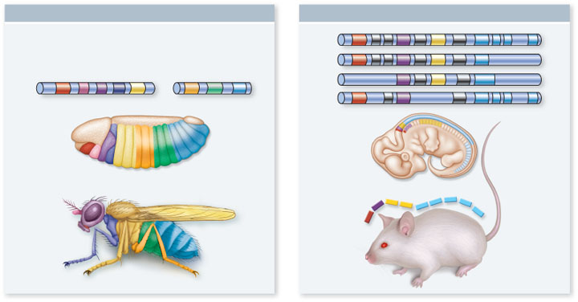
Production of Body Plan
Drosophila HOM Chromosomes
Mouse Hox Chromosomes
Drosophila HOM genes
Hox 1
Antennapedia complex
Bithorax complex
Hox 2
lab
pb
Dfd
Scr
Antp
Ubxabd-Aabd-B
Hox 3
Head
Thorax
Abdomen
Hox 4
Fruit fly
embryo
Mouse
embryo
Fruit fly
Mouse
a.
b.

Slide 64
Morphogenesis
Morphogenesis is the formation of ordered form and structure
-Animals achieve it through changes in:
-Cell division
-Cell shape and size
-Cell death
-Cell migration
-Plants use these except for cell migration

Slide 65
Morphogenesis
Cell division
-The orientation of the mitotic spindle determines the plane of cell division in eukaryotic cells
-If spindle is centrally located, two equal-sized daughter cells will result
-If spindle is off to one side, two unequal daughter cells will result

Slide 66
Morphogenesis
Cell shape and size
-In animals, cell differentiation is accomplished by profound changes in cell size and shape
-Nerve cells develop long processes called axons
-Skeletal muscles cells are large and multinucleated

Slide 67
Morphogenesis
Cell death
-Necrosis is accidental cell death
-Apoptosis is programmed cell death
-Is required for normal development in all animals
-“Death program” pathway consists of:
-Activator, inhibitor and apoptotic protease

Slide 68
Morphogenesis
Cell migration
-Cell movement involves both adhesion and loss of adhesion between cells and substrate
-Cell-to-cell interactions are often mediated through cadherins
-Cell-to-substrate interactions often involve complexes between integrins and the extracellular matrix (ECM)

Slide 69
Environmental Effects
Both plant and animal development are affected by environmental factors
-Germination of a dormant seed proceeds only under favorable soil and day conditions
-Reptiles have a temperature-dependent sex determination (TSD) mechanism
-The water flea Daphnia changes its shape after encountering a predatory fly larva

Slide 70
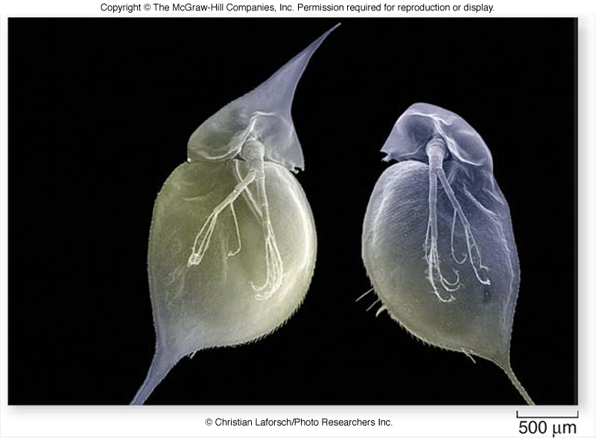
Environmental Effects
“Helmet Head” in Daphnia

